Slide 1
Flakers
Siddhartha Lavu, Bharath Venkateswaran,
Pranay Boppana, Aditya Srinivasan
Notes:
Introduce team here

Slide 2
How do we improve Productivity?
Time management Remove distractions
Accountability Motivation Clear Goals
Notes:
Problem we identified - lack of accountability towards your goals
Tell our story - going to gym, studying

Slide 3
Solution
Clear Goals
Motivation
Accountability
This is where Flake comes in
Notes:
Solution - keeping track of your progress with your friends to hold you accountable
Allowing friends to be able to motivate you and track progress together
Motivation
My friend Pranay and I were trying to start going to the gym and the way we held each other accountable

Slide 4
Flake
Not Just Another Photo Share App

Slide 5
Flake
Product features
Commit to a goal with your friends
Ability to add unlimited number of friends to a goal
Motivate each other every day by posting a picture of the goal
Users will also be notified you when a friend posts their goal
This will motivate the user to be accountable and work towards the goal as well
App will also try to notify and motivate you to accomplish your goal
Goal streaks
If the user posts a goal picture for a consecutive number of days they will receive “achievements or badges”.
Also track private goals
Private feed to track users individual goals
Pictures will come with a timestamp and geotag
Notes:
Accountability through daily photo progress uploads that can be shared with friends to hold everyone responsible - push your friends to accomplish their goals

Slide 6
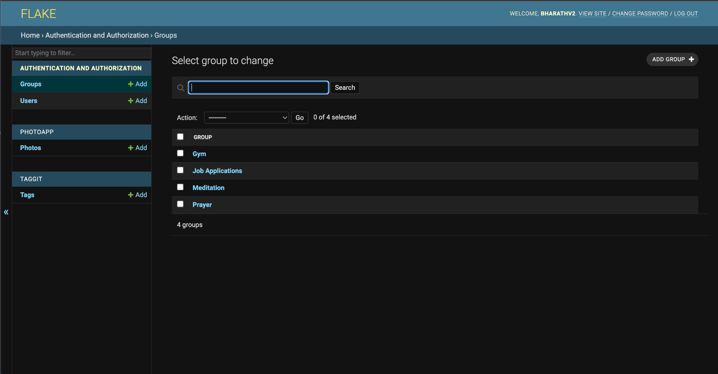
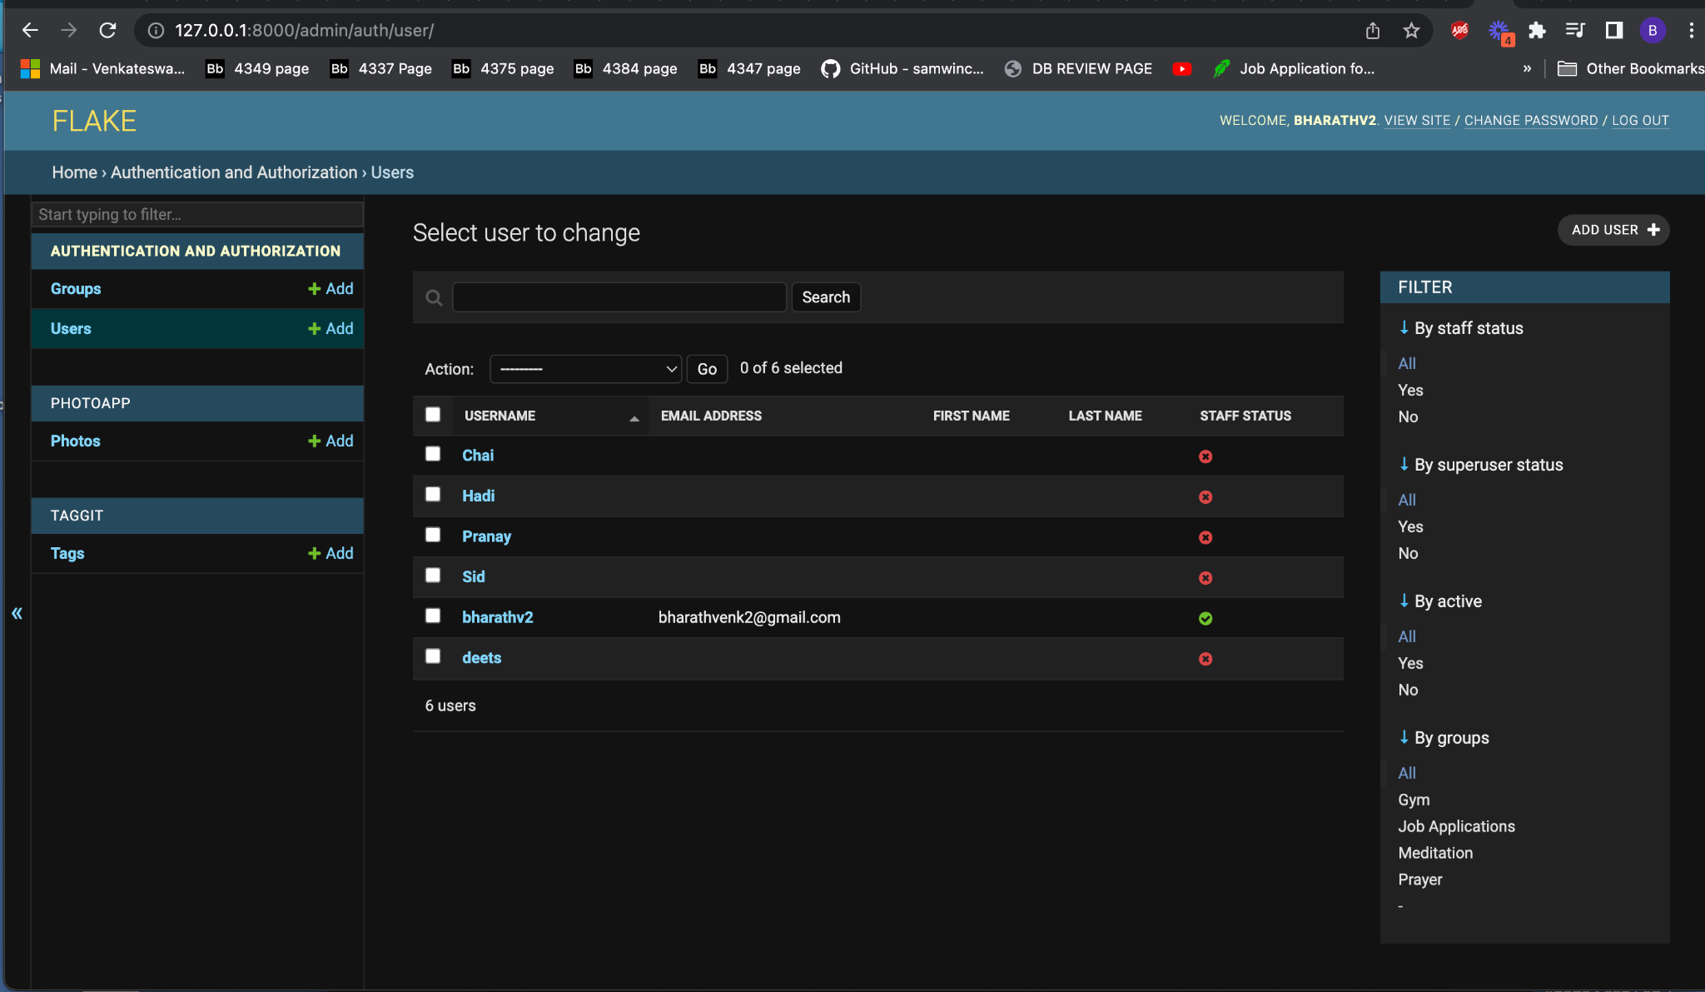
Prototype

Slide 7
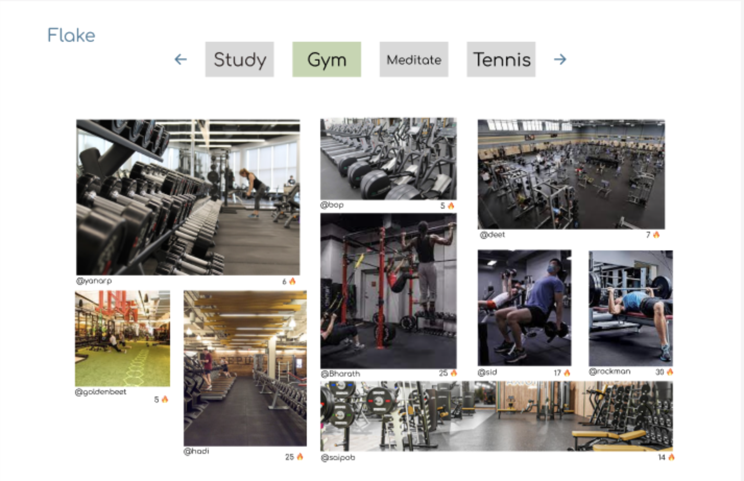
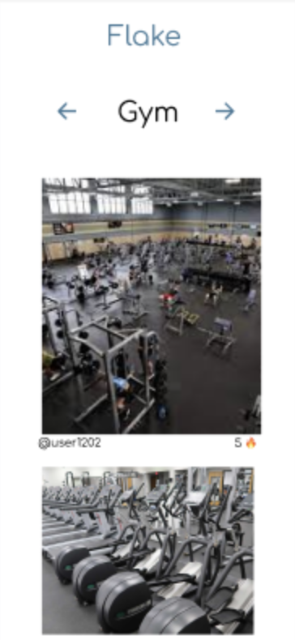
Prototype

Slide 8
Looking ahead
Poke friends to motivate them
Connect with others that have similar goals
Curated timelapse to show goal progression
Further goal customization - length, duration, etc.

Slide 9
Questions?

